Slide 1


The Family
[Professor Name]
[Class and Section Number]
Notes:
Classroom Recommendations: This PowerPoint is designed to present this information over the course of two (75-minute) days. If you only have one day to present this information or your class is 50-minutes, you will need to delete some discussion questions and perhaps some material. The activities could be converted to homework assignments to free up class time.
Overview: The family development module introduces students to different kinds of families, definition of a family, and the development path of a family. The accompanying PowerPoint presentation provides material for your class, including activities and discussion questions, which are designed to help keep your students interested and engaged in the material.
Technical Note: These slides may contain simple click animation so that you can focus students’ attention on a particular question, a selection of text, or an image and not have them be distracted by reading ahead. You can either preview the sequence of animation by going through the slides in slideshow view, visiting the animations tab, or reviewing the slide notes. In the notes you will see a cue - (Click) – that corresponds to each animation.
You may also find hyperlinks to outside videos at various places in the slides. These hyperlinks are embedded in text and indicated by color and in the notes section.

Slide 2
Learning Objectives
Understand the various family forms.
Describe attachment theory.
Identify different parenting styles.
Know the typical developmental trajectory of families.
Understand cultural differences in dating, marriage, and divorce.
Explain the influence of children and aging parents on families.
Know concrete tips for increasing happiness within your family.
Notes:
This slide outlines the learning objectives of the module.

Slide 3
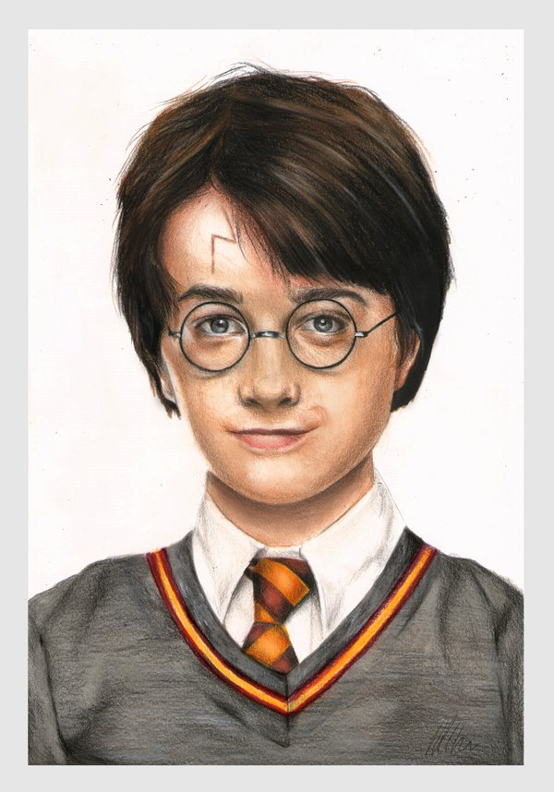
Activity: Harry Potter’s Family
As a child, do you think Harry Potter thought of his aunt, uncle, and cousin as family? Why or why not?
Once Harry met Ron’s family, the Weasleys, do you think it changed his idea of family? Why or why not?
Notes:
The purpose of this slide is to introduce the concept of family, including who might be considered family and who might not.
Time: 10-15 minutes
Materials: Ability to show a video clip
Show the video at https://www.youtube.com/watch?v=GHXSvCMpCGM, which is a 1 minute, 50 second clip from Harry Potter and the Philosopher’s Stone. It shows how Harry Potter is treated by his aunt, uncle, and cousin, who are all blood relatives. His aunt and uncle clearly treat him differently than their son.
Discussion Question: As a child, do you think Harry Potter thought of his aunt, uncle, and cousin as family? Why or why not?
The students will likely start discussing what makes a family. Harry is biologically related to the 3 people in the film clip, but the module says that the common thread among families is caring, commitment, and close emotional ties.
Discussion Question: Once Harry met Ron’s family, the Weasley’s, do you think it changed his idea of family? Why or why not?
The Weasley’s do clearly illustrate caring, commitment, and close emotional ties. They are also warm toward and supportive of Harry. The contrast between families will likely bring up what students think are essential components of a family.
(Click): Dudley’s Birthday
This links to https://www.youtube.com/watch?v=GHXSvCMpCGM, which is a 1 minute, 50 second clip from Harry Potter and the Philosopher’s Stone. It shows how Harry Potter is treated by his aunt, uncle, and cousin, all blood relatives. His aunt and uncle clearly treat him differently than their son.
(Click): As a child, do you think Harry Potter thought of his aunt, uncle, and cousin as family? Why or why not?
The students will likely start discussing what makes a family. Harry is biologically related to the 3 people in the film clip, but the module says that the common thread among families is caring, commitment, and close emotional ties.
(Click): Once Harry met Ron’s family, the Weasley’s, do you think it changed his idea of family? Why or why not?
The Weasley’s do clearly illustrate caring, commitment, and close emotional ties. They are also warm toward and supportive of Harry. The contrast between families will likely bring up what students think are essential components of a family.

Slide 4
Overview
What is Family?
Traditional and Modern Families
Family of Orientation, Family of Procreation, and Joint Families
Family Systems Theory
How Families Develop
Healthy, Happy Families
Notes:
The purpose of this slide is to provide students with an overview of the material that will be covered during the lecture.

Slide 5

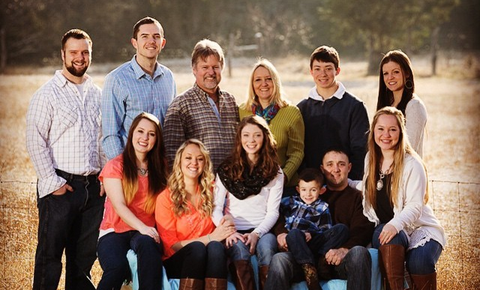
What is Family?
Traditional
Nuclear family
Two-parent family
Modern
Single parent families
Blended families
Foster families
Childfree families
Same-sex couples
And many others
Notes:
This slide introduces the idea of traditional families and modern families.
(Click): Traditional Family
The module defines a traditional family: “two or more people who are related by blood, marriage, and – occasionally – adoption.”
(Click): Nuclear family
The nuclear family is a family comprised of only parents and children.
(Click): Two-parent family
A two-parent family is a family with two parents, often a mother and a father.
.
(Click): Modern Family
Not everyone belongs to a traditional family, and the definition of a traditional family has been criticized. The common thread among all of the modern families listed is caring, commitment, and close emotional ties.
(Click): Single parent families
Not all children are born into families with two parents. Additionally, some couples in a two-parent family may divorce or one of them may die.
(Click): Blended families
Many people’s parents divorce and when one or both of their parents re-marry, they become part of a blended family or a stepfamily, which includes a step-parent and perhaps step-siblings.
(Click): Foster families
Not all children are raised by someone biologically related to them. Some children are placed into foster care, and they become part of a foster family.
(Click): Childfree families
More people are choosing to remain childfree than in the past, and couples who do not have children are still a family.
(Click): Same-sex couples
Many people’s idea of a traditional family does not include a same-sex couple, but modern families open up the conception of family to same-sex couples.
(Click): And many others
At this point, if you have time, you may ask students if they can think of any other types of families. If you do not have time, you can simply point out that you have discussed some types of families but there can be more.

Slide 6

What is a Family?
Some people think of their pets as a member of their family. What do you think? Do pets count as family members?
Notes:
This slide includes a discussion question prompt.
(Click): Some people think of their pets as a member of their family. What do you think? Do pets count as family members?
This question is likely to illicit different viewpoints. The point is to get students thinking about exactly what a family is, and, regardless of whether students think pets should be counted as family members, the discussion can generate students’ ideas about family. You might remind students that the module says the common thread among families is caring, commitment, and close emotional ties.

Slide 7
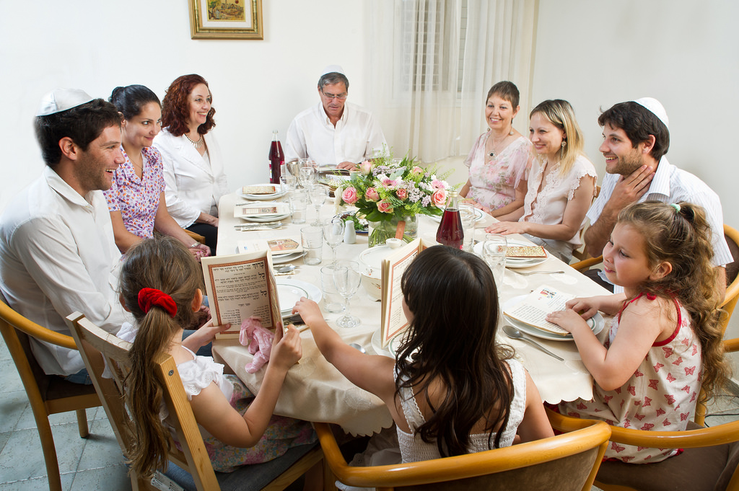
What is Family?
Family of Orientation
Family of Procreation
Joint Family
Notes:
This slide can help you discuss some other types of families.
(Click): Family of Orientation
The family that a person is born into is their family of orientation. This could be a modern family or a traditional family.
(Click): Family of Procreation
A family of procreation is the family a person starts when they leave their family of orientation to start their own family.
(Click): Joint Family
Some people do not leave their family of orientation to start a family of procreation. Joint families are when three or more generations of blood relatives live in the same house or compound. The module also uses the term, multigenerational households, later in the module.

Slide 8
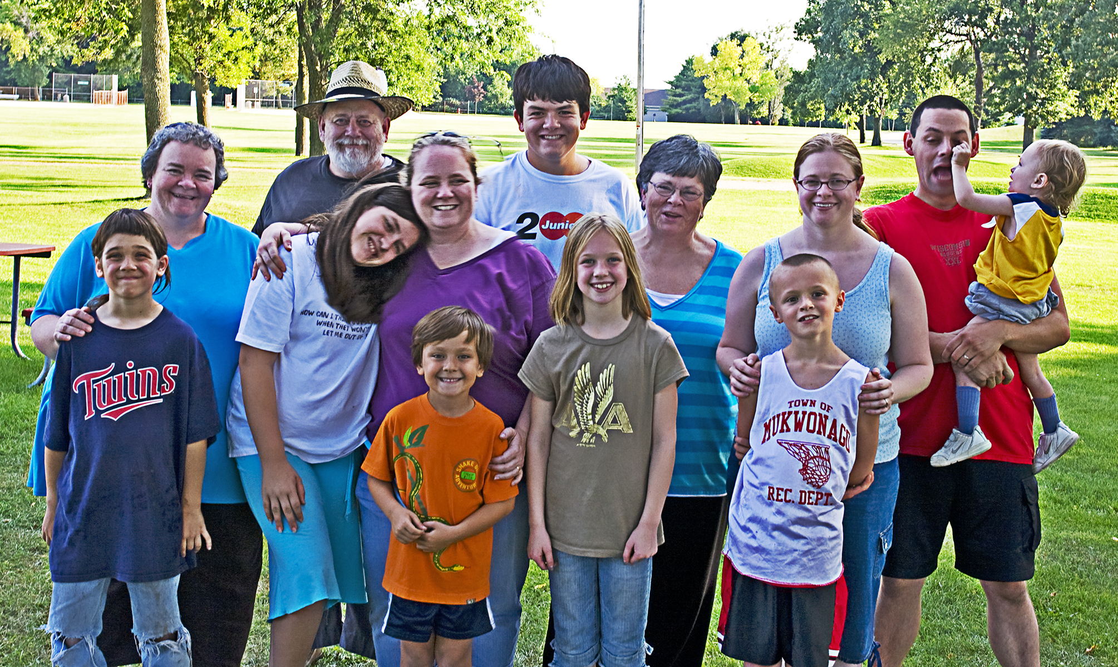
What is Family?
Family Systems Theory
Notes:
This slide introduces the concept of family systems theory.
(Click): Family Systems Theory
Family systems theory says that a person cannot be understood without understanding the role that person plays in their family. Every person has a role in their family, and each role has a set of rules and expectations. The family wants stability, so any change an individual in a family makes may cause each family member to adjust and change. The module gives the example of Cinderella to illustrate family systems theory.
From the Module:
“Take, for example, the classic story of Cinderella. Cinderella’s initial role is that of a child. Her parents’ expectations of her are what would be expected of a growing and developing child. But, by the time Cinderella reaches her teen years, her role has changed considerably. Both of her biological parents have died and she has ended up living with her stepmother and stepsisters. Cinderella’s role shifts from being an adored child to acting as the household servant. The stereotype of stepfamilies as being emotionally toxic is, of course, not true. You might even say there are often-overlooked instructive elements in the Cinderella story: Her role in the family has become not only that of servant but also that of caretaker-- the others expecting her to cook and clean while in return they treat her with spite and cruelty. When Cinderella finds her prince and leaves to start her own family—known as a family of procreation—it is safe to assume that the roles of her stepmother and stepsisters will change—suddenly having to cook and clean for themselves”.

Slide 9
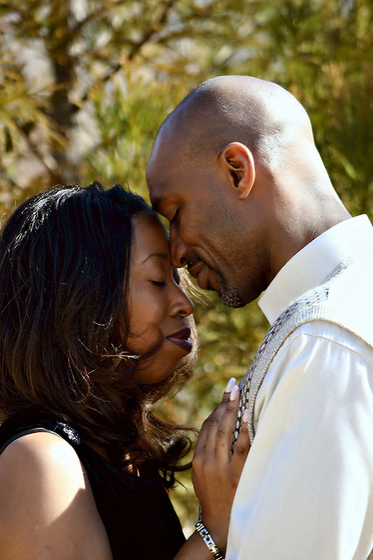
Activity: Your Romantic Style
Fill out the Experiences in Close Relationship Scale-Short Form (ECR-S)
Come up with a score for Anxiety and a score for Avoidance
Notes:
This activity introduces the idea of romantic attachment styles and gives each student some information about their romantic attachment style.
Time: 10 minutes
Materials: Handouts of Close Relationship Scale-Short Form and scoring instructions (links above).
(Click): Fill out the Experiences in Close Relationship Scale-Short Form (ECR-S)
Have students fill out the scale, which can be found at can be found at http://wei.public.iastate.edu/manuscript/ECR-S.pdf
(Click): Follow the instructions to come up with a score for Anxiety and a score for Avoidance
Students can then score the scales, which will give them a score for anxiety and score for avoidance. Instructions are available at http://wei.public.iastate.edu/manuscript/ECR-S.pdf. You may have to help students reverse score the items when coming up with their scores.

Slide 10
Overview
What is Family?
How Families Develop
Attachment Style
Dating, Marriage, and (Possibly) Children
Parenting Style
Parenting in Later Life
Family Issues and Considerations
Healthy Happy Families
Notes:
This slide orients students to where the class is in the overview.

Slide 11
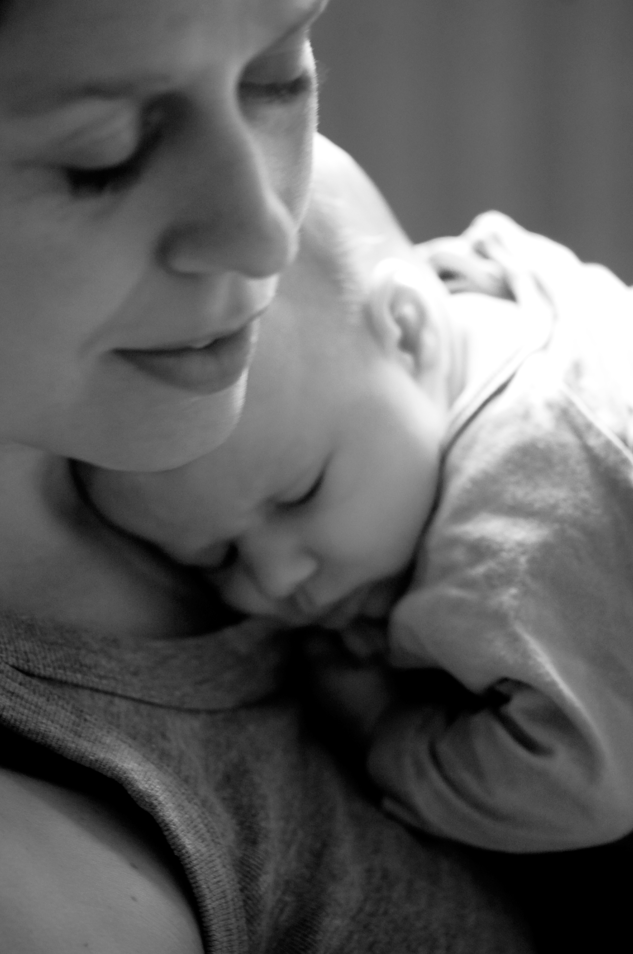
How Families Develop
Attachment Styles
Secure
Anxious-avoidant
Anxious-resistant
Coherence
Notes:
This slide can help you attachment style and how it relates to adult romantic relationships.
(Click): Attachment Styles
The close relationships we have when we are young can affect the types of relationships we seek when we are adults. Attachment theory is one way to explain how our working models of how relationships work that we learn in childhood affect our relationships as adults.
(Click): Secure attachment
Secure attachment is likely to occur when a parent is responsive, soothing children when they cry, for example. 60% of children in the U.S. have secure attachment.
(Click): Anxious-resistant
About 20% of children have an anxious-resistant attachment style. Adults who had an anxious-resistant (sometimes called anxious-preoccupied) attachment with their parent often worry that others will not love them and sometimes find that romantic partners do not want to get as close to them as they would like.
(Click): Anxious-avoidant
Another 20% of children in the U.S. have an anxious-avoidant attachment style. Adults who had an anxious-avoidant attachment style with their parents are not likely to want to get close to romantic partners and may not care too much about intimate relationships. It can be uncomfortable for them to be close to or rely on others.
(Click): Coherence
Our attachment styles, however, can change. Coherence is when an adult gains insight about their childhood experiences and realizes that it does not mean that they are unworthy of love or that others are untrustworthy. Please note that you will likely have students who were not securely attached to at least one of their parents, and they may be uncertain of their future romantic relationship prospects. Emphasizing that romantic attachment styles can change with some work will likely be helpful for those students.

Slide 12

CAT: The Muddiest Point
What was the muddiest point in today’s class?
Write down what concept you are still struggling to understand.
Notes:
Classroom Assessment Technique (CAT): The Muddiest Point
Ask students to write down the “muddiest point” – that is any concept they are still struggling to understand of any questions they still may have about the material. With remaining class time, ask students to share their muddiest point and provide additional review on these points.
If you do not conclude with this Classroom Assessment Technique (CAT), it would helpful to use another CAT. It could be in the form of a:
Muddy point
One-minute paper
Background knowledge
What’s the Principle?
Defining features Matrix:
For more information on CATs click here: http://cft.vanderbilt.edu/guides-sub-pages/cats/

Slide 13
Overview
What is Family?
How Families Develop
Attachment Style
Dating, Marriage, and (Possibly) Children
Parenting Style
Parenting in Later Life
Family Issues and Considerations
Healthy Happy Families
Notes:
This slide orients students to where the class is in the overview.
If you did the Muddiest Point CAT at the end of last class, be sure to answer any questions students had and clear up any misunderstandings before moving on to new material.

Slide 14
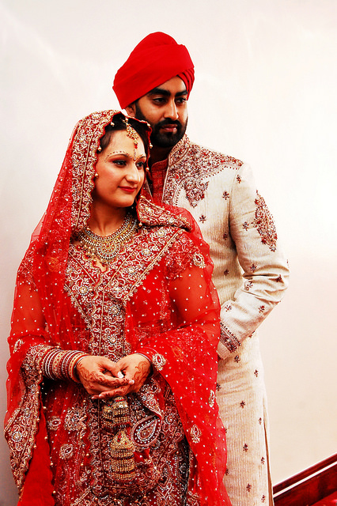
How Families Develop
Dating, Marriage, and (Possibly) Children
Marriage Market
Homogamy
Cohabitation
Engagement and Marriage
Children or Childfree?
Notes:
This slide will help you discuss some topics in the module centered around dating, marriage, and children.
(Click): Dating, Marriage, and (Possibly) Children
This slide explores the topics of dating, marriage, and children.
(Click): Marriage Market
The marriage market is how we compare potential mates and find the best option for us. How we find potential romantic partners has changed dramatically over time. Technology now allows us to be able to connect with people who are far away from us geographically. It also lets us filter out individuals we don’t want by characteristics such as age or interests. Some cultures have a physical marriage market, such as the Shaghai Marriage Market, where parents trade information about their children in order to try to find a suitable mate for them. In India, there are marriage brokers or marriage bureaus that help people find partners. Some cultures have arranged marriages as opposed to love marriages, and, in fact, they can be the preferred way to get married.
(Click): Homogamy
People tend to end up with romantic partners who are very similar to us, which is homogamy. For example, highly educated people tend to marry other highly educated people. People commonly end up with partners who are similar to them in age, race, social status, and religion. We also tend to end up with people geographically close to us (proximity) and similar to us in physical attractiveness.
(Click): Cohabitation
Cohabitation, romantic partners living together without being married, is on the rise, and it is common in many countries, especially Scandinavian countries of Norway, Sweden, and Iceland. Some cohabitating couples eventually get married while others do not, which has lead to a discussion of whether cohabitation is a step in the progression toward marriage.
(Click): Engagement and Marriage
Engagement is an agreement to get married. The module discusses some differences in engagement across cultures. In some cultures the engagement ring is worn on the right hand and in others it is worn on the left hand. In some cultures, the man proposes, while in others the family proposes. Most people around the world get married (80% by age 49), but they are getting married later in life now than they have in the past, with men getting married later on average compared to women. In addition, more people prefer to stay single than ever before. People in more developed countries are getting married later compared to those in developing countries.
(Click): Children or childfree?
More and more people are postponing having children or choosing to not have children. Couples who choose not to have children are childfree. There are positives to having children (increase in well-being, being more positive about their lives) and negatives to having children (more likely to be depressed, report lower levels of marital quality), based on the research.

Slide 15
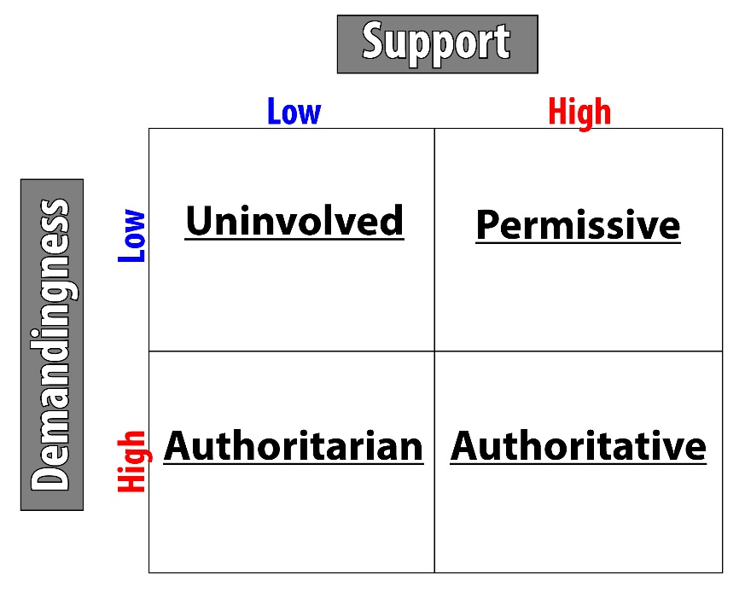
How Families Develop
Parenting Styles
Authoritative
Authoritarian
Permissive
Uninvolved
Notes:
This slide can help you explain parenting styles
(Click): Parenting Styles
Parents have different parenting styles. They can be explained with the grid on the right (also in the module). “Support refers to the amount of affection, acceptance, and warmth a parent provides. Demandingness refers to the degree a parent controls his/her child’s behavior.”
(Click): Authoritative
Authoritative parents expect a lot but are supportive and affectionate, and this parenting style is seen as a positive one. Children of authoritative parents tend to be happy and successful. Authoritative parenting seems to work in a variety of different cultures, but some have argued it works best in Western, industrialized cultures.
(Click): Authoritarian
Authoritarian parents are demanding (controlling) yet are not supportive. Children of authoritarian parents are more likely to be obedient but less likely to be happy.
(Click): Permissive
Permissive parents are supportive but not demanding. Their children score lower on happiness and self-regulation, and they are likely to have issues with authority.
(Click): Uninvolved
Uninvolved parents are not supportive or demanding, and children of uninvolved parents score lowest on self-control, self-esteem, and competence.

Slide 16
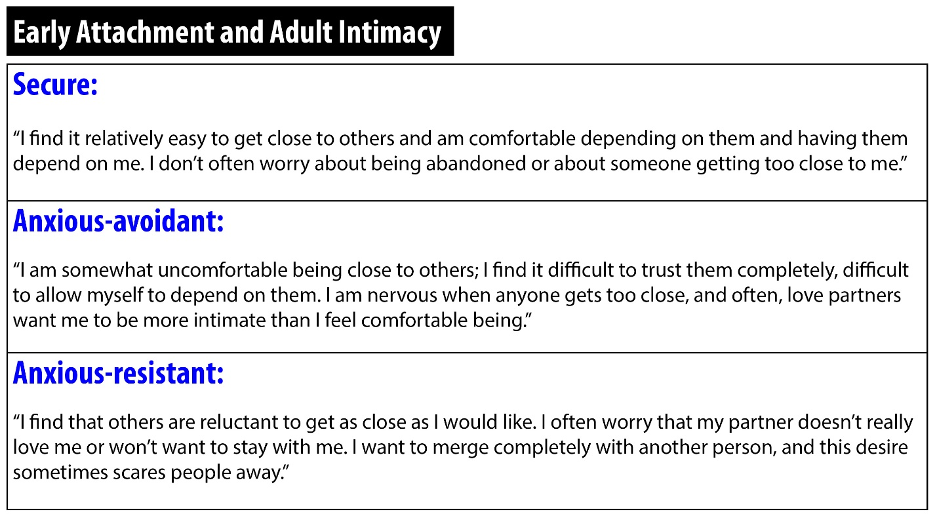
How Families Develop
Notes:
This slide can further help you explain how attachment style relates to adult romantic relationships. This table is from the module.

Slide 17
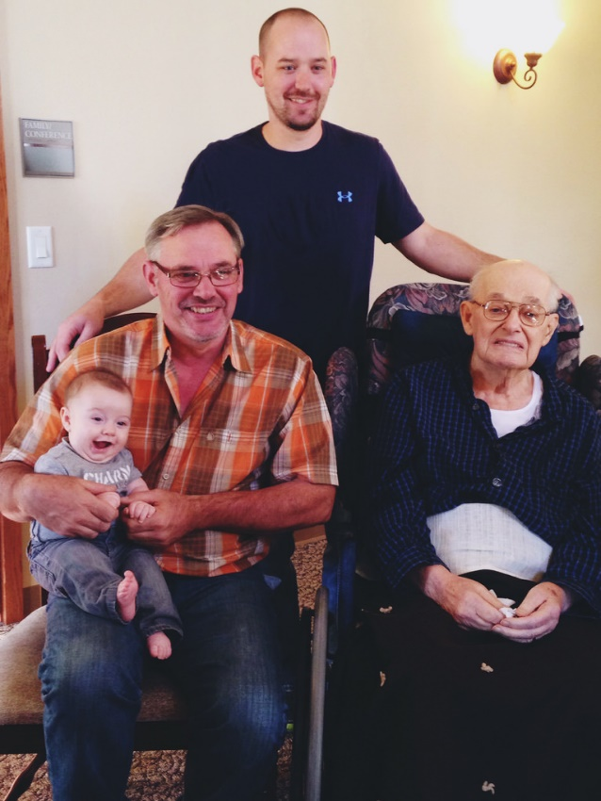
Activity: Do Perfect Parents Make Perfect Children?
Which factors show a strong correlation (positive OR negative!) with test scores between kindergarten and 5th grade?
There are eight that are strongly correlated and eight that aren’t.
Notes:
This slide introduces the activity, Do Perfect Parents Make Perfect Children?
Time: 15-20 minutes
Based on an activity in the book, Freakonomics
This activity was taken from this TOPIX page: http://topix.teachpsych.org/w/page/19980987/Development%20in%20the%20Classroom
Give students the first handout, which can be downloaded from: http://topix.teachpsych.org/w/file/86713183/Do%20Perfect%20Parents%20make%20Perfect%20Children%20(1).doc
This handout asks students which of the 16 statements have a strong correlation with academic test scores between kindergarten and 5th grade and which do not. There are 8 statements that have a strong correlation and 8 that do not.
Here are the first three statements as an example:
The child has highly educated parents.
The child’s family is intact.
The child’s parents have high socioeconomic status.
Give students the second handout, which can be downloaded from http://topix.teachpsych.org/w/file/86713198/Do%20Perfect%20Parents%20-%20answers%20(1).doc
This handout reveals which are correlated and which are not. In addition, it explains why some have relationships and why some do not. It includes a conclusion which sums up some of the findings, saying that the items that are correlated are about what parent are (socioeconomic status, age, etc.) and the items that are not correlated are about what parents do (take children to museums, let them watch television).

Slide 18
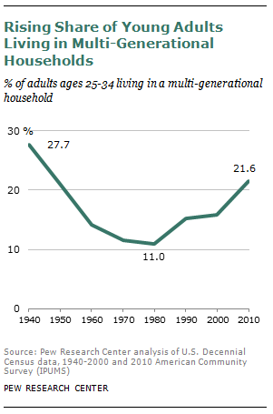
Parenting in Later Life
Empty nest
Boomerang generation
Sandwich generation
Why do you think more people aged 25-34 are living with their parents than in recent years?
Notes:
This slide introduces the topic of parenting in later life. The image is taken from http://www.pewsocialtrends.org/2012/03/15/the-boomerang-generation/, which also contains a report about the boomerang generation.
(Click): Empty nest
The sadness some parents experience when children leave is referred to as empty nest.
(Click): Boomerang generation
However, some adult children leave and then come back home. The boomerang generation is term used to describe children, often between the ages of 25 and 34, who come back to live with their parents. Almost half report paying rent, and most report helping with household expenses. Some of these children do report that coming back to live with their parents has hurt their relationship with their parents.
(Click): Sandwich generation
Middle-aged parents may also be taking care of their own parents, as their parents age. The sandwich generation is the group of people taking care of both their children and their parents. Some cultures have the expectation that as people grow older they will age in place or stay home with modifications being made, if necessary. This can result in multigenerational households. Other cultures believe aging parents should live independently or go to long-term care facilities.
(Click): Why do you think more people aged 25-34 are living with their parents than in recent years?
This is a discussion question, designed to get students engaged in the topic. Students are likely to bring up issues such as finances. If you teach at an institution where there are non-traditional students, they may themselves be a part of the boomerang generation.
Image Source:
Pew Research Center. (2012). The Boomerang generation. Retrieved from: http://www.pewsocialtrends.org/files/2012/03/PewSocialTrends-2012-BoomerangGeneration.pdf

Slide 19
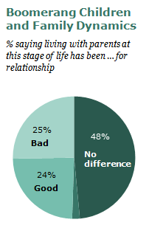
Parenting in Later Life
What are some difficulties that might occur when adult children live with their parents?
Notes:
This slide continues the topic of parenting in later life. The image is from http://www.pewsocialtrends.org/2012/03/15/the-boomerang-generation/, which includes a report and more data about the boomerang generation.
(Click): What are some difficulties that might occur when adult children live with their parents?
This discussion question will hopefully get students to think about how changes in families affect family members. There will likely be an opportunity to relate the discussion back to family systems theory, including the idea that any change a family member makes can cause all family members to shift and change.
Image Source:
Pew Research Center. (2012). The Boomerang generation. Retrieved from: http://www.pewsocialtrends.org/files/2012/03/PewSocialTrends-2012-BoomerangGeneration.pdf

Slide 20
Overview
What is Family?
How Families Develop
Family Issues and Considerations
Divorce
Adoption
Healthy Happy Families
Notes:
This slide orients students to where the class is in the overview.
If you did the Muddiest Point CAT at the end of last class, be sure to answer any questions students had and clear up any misunderstandings before moving on to new material.

Slide 21
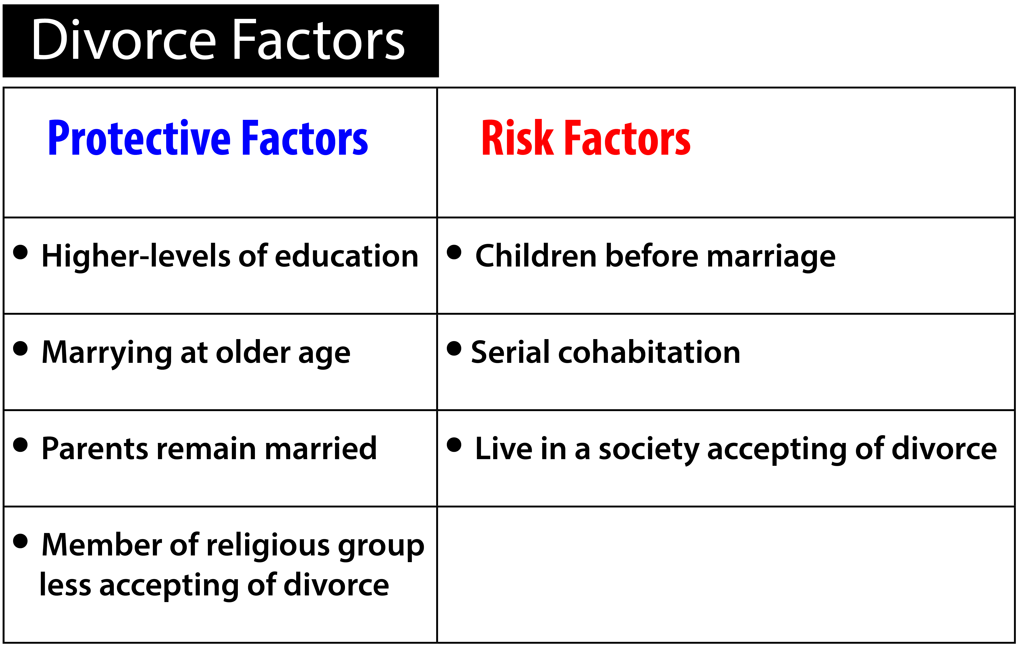
Family Issues and Considerations
Notes:
This slide introduces divorce. The table is from the module, and it includes both risk and protective factors for divorce.
Divorce occurs when a marriage is ended legally. The current divorce rate (higher after declines in the 1980s and 1990s) is 50%, although there is some debate about that number. The risk of divorce goes for up subsequent marriages, so that the risk of divorce for someone marrying the second time is higher than the first time.
There are some protective factors that are associated with a lower risk of divorce. This included pursuing education and marrying when you are older. Factors that increase the risk of divorce include living with multiple partners before marrying (serial cohabitation) and having a child before marriage. Divorce is also more likely in countries where divorce is more socially acceptable.
If parents with children do divorce, it is helpful if those parents clearly convey to the children that the divorce is not their fault. It’s also helpful for parents to not bias children against their other parent or use children to hurt their ex-spouse.

Slide 22
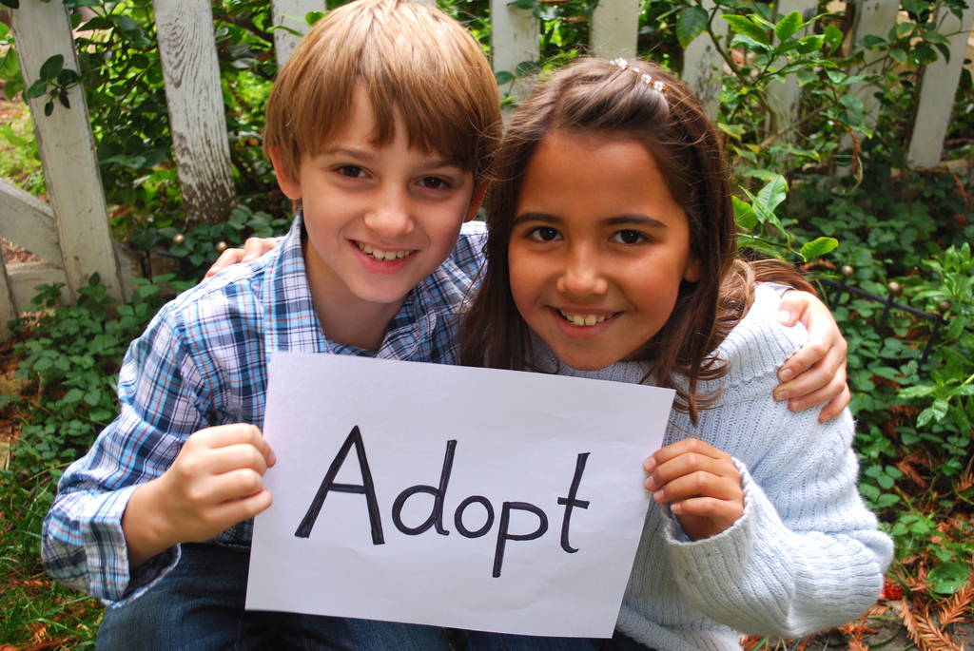
Family Issues & Considerations
Adoption
Notes:
This slide introduces the topic of adoption.
Adoption happens when a person or family legally takes in and raises a child from another family. Many children (100,000 in the U.S. in 2013) are in foster care and reside with foster families, and these children are awaiting adoption. Adopting children from the foster care system can be relatively inexpensive ($0-$2,500). International adoptions have been popular with people in America, but their numbers have been decreasing recently.

Slide 23
Overview
What is Family?
How Families Develop
Family Issues and Considerations
Healthy Happy Families
Notes:
This slide orients students to where the class is in the overview.
If you did the Muddiest Point CAT at the end of last class, be sure to answer any questions students had and clear up any misunderstandings before moving on to new material.

Slide 24
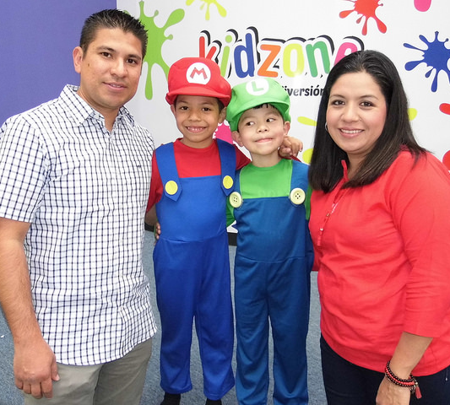
Happy Healthy Families
Teach morality
Savor the good
Use the extended family network
Create family identity
Forgive
Notes:
This slide will help you explain the last section of the module about things that are associated with happy, healthy families.
(Click): Teach morality
Moral development in children has been associated with a greater sense of well-being.
(Click): Savor the good
This includes savoring each other’s successes.
(Click): Use the extended family network
All members of the family, no matter their age, can help with caregiving responsibilities.
(Click): Create family identity
This includes sharing fond memories, creating inside jokes, and creating a story of the family.
(Click): Forgive
This involves not holding grudges against family members.

Slide 25
CAT: One-Minute Paper
What was the most important thing you learned during this class?
What important question remains unanswered?
Notes:
Classroom Assessment Technique (CAT): One-Minute Paper
If you are presenting the information on one class day, you might end the material about here. End your class time with a one-minute paper.
The Minute Paper tests how students are gaining knowledge, or not. The instructor ends class by asking students to write a brief response to the following questions: “What was the most important thing you learned during this class?” and “What important question remains unanswered?”
Have students briefly answer these questions in writing and turn them in. After class, assess students’ responses. At the beginning of the next class, go over any misunderstandings or relevant questions.
If you do not conclude with this Classroom Assessment Technique (CAT), it would helpful to use another CAT. It could be in the form of a:
Muddy point
One-minute paper
Background knowledge
What’s the Principle?
Defining features Matrix:
For more information on CATs click here: http://cft.vanderbilt.edu/guides-sub-pages/cats/

Slide 26
Photo Attribution
Slide 1 | Photo Credit: Family Laurel Harvey https://www.flickr.com/photos/80253127@N03/7529909200 https://creativecommons.org/licenses/by/2.0/
Slide 3 | Photo Credit: Harry Potter Molly Thomas http://mollythomas.deviantart.com/art/Harry-Potter-597230803 https://creativecommons.org/licenses/by-nc-nd/3.0/us/
Slide 5 | Photo Credit: Photo Credit: 10070052 moodboard https://www.flickr.com/photos/67835627@N05/7301109548/ https://creativecommons.org/licenses/by/2.0/ Photo Credit: The couple in the middle - the parents of this blended family - got married today! Doc List https://www.flickr.com/photos/digidragon/16173392089 https://creativecommons.org/licenses/by-nc-sa/2.0/
Slide 6 | Photo Credit: family Kristy Davies https://www.flickr.com/photos/kristykristydavies/4641173546 https://creativecommons.org/licenses/by-nc/2.0/
Slide 7 | Photo Credit: Passover traditional Seder_Jorge Novominsky JEN_ 9630 Israel_photo_gallery https://www.flickr.com/photos/99743724@N08/15366025786 https://creativecommons.org/licenses/by-nd/2.0/
Slide 8 | Photo Credit: Family Randen Pederson https://www.flickr.com/photos/chefranden/4034752817 https://creativecommons.org/licenses/by/2.0/
Slide 9 | Photo Credit: IMG_4484 Muriel HEARD-COLLIER https://www.flickr.com/photos/22540386@N03/4388337187/ https://creativecommons.org/licenses/by-nc-nd/2.0/
Slide 11 | Photo Credit: Secure Maessive https://www.flickr.com/photos/maessive/2118750914 https://creativecommons.org/licenses/by-nd/2.0/
Slides 12 & 25 | Photo Credit: Illustrated silhouette of a black cat nehtaeh79 http://www.freestockphotos.biz/stockphoto/16624 http://creativecommons.org/publicdomain/zero/1.0/
Slide 14 | Photo Credit: 2010-08-29cb United [Ananabanana] https://www.flickr.com/photos/45358973@N04/12362781564/ https://creativecommons.org/licenses/by-nc-sa/2.0/
Notes:
Photo Attribution Slide

Slide 27
Photo Attribution
Slide 15 | Image Credit: Four Parenting Styles Noba Staff https://creativecommons.org/licenses/by-nc-sa/4.0/deed.en_US
Slide 16 | Image Credit: Early Attachment and Adult Intimacy Noba Staff https://creativecommons.org/licenses/by-nc-sa/4.0/deed.en_US
Slide 17 | Photo Credit: davidmulder61 https://www.flickr.com/photos/113026679@N03/21933460598/ https://creativecommons.org/licenses/by-sa/2.0/
Slide 18 | Image credit: Taken from: Pew Research Center. (2012). The Boomerang generation. Retrieved from: http://www.pewsocialtrends.org/files/2012/03/PewSocialTrends-2012-BoomerangGeneration.pdf
Slide 19 | Image credit: Taken from: Pew Research Center. (2012). The Boomerang generation. Retrieved from: http://www.pewsocialtrends.org/files/2012/03/PewSocialTrends-2012-BoomerangGeneration.pdf
Slide 21 | Photo Credit: Divorce Factors Noba Staff https://creativecommons.org/licenses/by-nc-sa/4.0/deed.en_US
Slide 22 | Photo Credit: Adopt rumolay https://www.flickr.com/photos/92997382@N00/6335595756 https://creativecommons.org/licenses/by-nc-nd/2.0/
Slide 24 | Photo Credit: Festejan a Miguel y Humberto El Heraldo de Saltillo https://www.flickr.com/photos/124953100@N05/24962058564/ https://creativecommons.org/licenses/by-nc-sa/2.0/
Notes:
Photo Attribution Slide

